Slide 1
Popular Programming Tech
Part 3
Program Structure

Slide 2
Learning Objective
LO 1 : Explain fundamental concept of GO Programming Language

Slide 3
Outline
Names
Declarations
Variable
Assignments
Type declarations
Packages and Files
Scope

Slide 4
Intro
In Go, as in any other programming language, one builds large programs from a small set of basic constructs
Expressions are used in statements whose execution order is determined by control-flow statements like if and for.

Slide 5
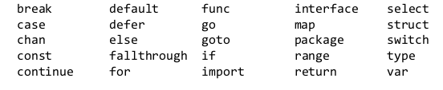
Names
The names of Go functions, variables, constants, types, statement labels, and packages follow a simple rule: a name begins with a letter (that is, anything that Unicode deems a letter) or an underscore and may have any number of additional letters, digits, and underscores.
Go has 25 keywords like if and switch that may be used only where the syntax permits; they can’t be used as names.

Slide 6
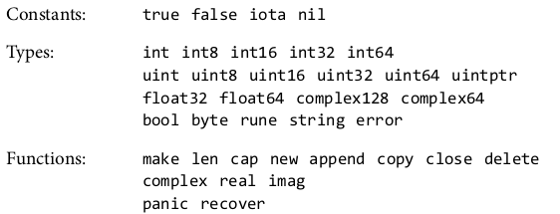
Names (cont..)

Slide 7
Declarations
A declaration names a program entity and specifies some or all of its properties
There are four major kinds of declarations: var, const, type, and func.
Go program is stored in one or more files whose names end in .go
Each file begins with a package declaration that says what package the file is part of

Slide 8
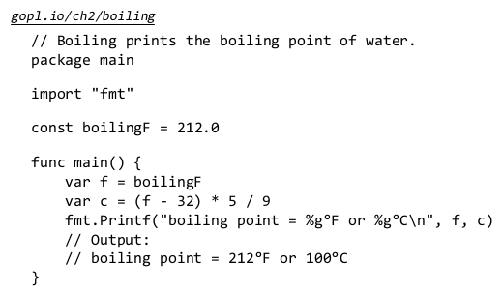

Slide 9
The constant boilingF is a package-level declaration (as is main), whereas the variables f and c are local to the function main
The name of each package-level entity is visible not only throughout the source file that contains its declaration, but throughout all the files of the package
A function declaration has a name, a list of parameters (the variables whose values are provided by the function’s callers), an optional list of results, and the function body, which contains the statements that define what the function does

Slide 10
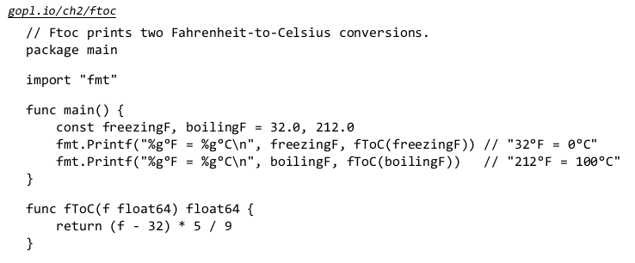

Slide 11
Variables
A var declaration creates a variable of a particular type, attaches a name to it, and sets its initial value
Either the type or the = expression part may be omitted, but not both.
If the type is omitted, it is determined by the initializer expression. If the expression is omitted, the initial value is the zero value for the type, which is 0 for numbers, false for booleans, "" for strings, and nil for interfaces and reference types (slice, pointer, map, channel, function)

Slide 12

Variables
The zero-value mechanism ensures that a variable always holds a well-defined value of its type
in Go there is no such thing as an uninitialized variable. This simplifies code and often ensures sensible behavior of boundary conditions without extra work
It is possible to declare and optionally initialize a set of variables in a single declaration, with a matching list of expressions
A set of variables can also be initialized by calling a function that returns multiple values:

Slide 13

Short Variable Declarations
Within a function, an alternate form called a short variable declaration may be used to declare and initialize local variables
It takes the form name := expression, and the type of name is determined by the type of expression.

Slide 14
Keep in mind that := is a declaration, whereas = is an assignment
A multi-variable declaration should not be confused with a tuple assignment (§2.4.1), in which each variable on the left-hand side is assigned the corresponding value from the right-hand side

Slide 15
Pointers
A variable is a piece of storage containing a value. Variables created by declarations are identified by a name, such as x, but many variables are identified only by expressions like x[i] or x.f
A pointer value is the address of a variable. A pointer is thus the location at which a value is stored.
Not every value has an address, but every variable does.
With a pointer, we can read or update the value of a variable indirectly, without using or even knowing the name of the variable, if indeed it has a name.

Slide 16


Slide 17
Variables are sometimes described as addressable values. Expressions that denote variables are the only expressions to which the address-of operator & may be applied.
The zero value for a pointer of any type is nil. The test p != nil is true if p points to a variable
Pointers are comparable; two pointers are equal if and only if they point to the same variable or both are nil.

Slide 18

The New Function
Another way to create a variable is to use the built-in function new
The expression new(T) creates an unnamed variable of type T, initializes it to the zero value of T, and returns its address, which is a value of type *T

Slide 19
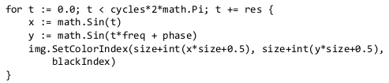
Lifetimes of Variables
The lifetime of a variable is the interval of time during which it exists as the program executes
The lifetime of a package-level variable is the entire execution of the program
By contrast, local variables have dynamic lifetimes: a new instance is created each time the declaration statement is executed, and the variable lives on until it becomes unreachable, at which point its storage may be recycled

Slide 20

Assignments
The value held by a variable is updated by an assignment statement, which in its simplest form has a variable on the left of the = sign and an expression on the right.

Slide 21
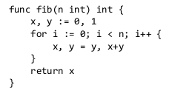
Tuple Assignment
Another form of assignment, known as tuple assignment, allows several variables to be assigned at once
All of the right-hand side expressions are evaluated before any of the variables are updated, making this form most useful when some of the variables appear on both sides of the assignment

Slide 22
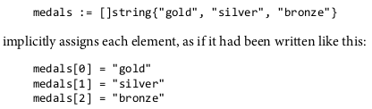
Assignability
Assignment statements are an explicit form of assignment, but there are many places in a program where an assignment occurs implicitly
a function call implicitly assigns the argument values to the corresponding parameter variables
a return statement implicitly assigns the return operands to the corresponding result variables

Slide 23
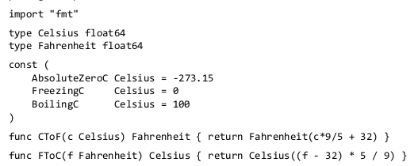
Type Declarations
The type of a variable or expression defines the characteristics of the values it may take on, such as their size (number of bits or number of elements, perhaps), how they are represented internally, the intrinsic operations that can be performed on them, and the methods associated with them.

Slide 24
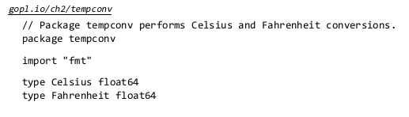
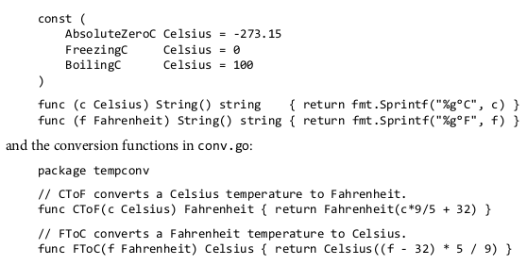
Packages and Files
Packages in Go serve the same purposes as libraries or modules in other languages, supporting modularity, encapsulation, separate compilation, and reuse

Slide 25
References
https://go.dev/doc/install
https://www.golangprograms.com/go-language/variables.html

